Slide 1
Hack the Future:
A Gen AI Sprint Powered by Data

Slide 2





Hack the Future: A Gen AI Sprint Powered by Data
Data and AI Week
Team details
TEAM NAME: VISIONARIES
Name-Anvit Kumar
Name-Bhavya Gera
Photo

Slide 3
Summary
Idea Title | Smart-Retail: A Multi-Agent AI System for Autonomous Inventory and Pricing Optimization
Team Name | Visionaries
Problem Statement | Optimizing Retail Inventory with Multi Agent
Proposed Solution | A Smart-Retail, a multi-agent AI system designed to autonomously manage demand forecasting, inventory control, and dynamic pricing in retail environments. The system is built on three intelligent agents: Demand Forecasting Agent Inventory Monitoring Agent Pricing Optimization Agent which communicate asynchronously via a message queue system (e.g., Kafka) to ensure real-time, scalable, and adaptive inventory management.

Slide 4
Problem statement
In today’s fast-paced retail industry, businesses struggle to strike a balance between product availability and inventory costs. Manual or semi-automated processes often lead to:
Stockouts, resulting in missed sales opportunities and poor customer satisfaction.
Overstocking, leading to high holding costs, wastage (especially for perishables), and markdown losses.
Ineffective pricing strategies, where prices are not dynamically aligned with demand, competition, or inventory levels.
Traditional inventory and pricing systems are often reactive, siloed, and lack the agility to respond to real-time market dynamics, seasonal shifts, and evolving customer behavior.

Slide 5
Proposed Solution Overview
The challenges of inefficient inventory management, stock imbalances, and static pricing, we propose a Multi-Agent AI System called “Smart-Retail”. This system brings intelligence, autonomy, and coordination across the entire retail supply chain using a modular agent-based architecture.
Approach and Methodology
1. Multi-Agent Framework
We design three core AI agents, each responsible for a critical component of the retail system:
Demand Forecasting Agent :-
Uses machine learning models (like LSTM, XGBoost, or Prophet) on historical sales data, seasonality, promotions, and external factors to predict future product demand at store level.
Inventory Monitoring Agent :-
Continuously tracks real-time stock levels, supplier lead times, warehouse capacity, and product expiry to compute reorder points and safety stock levels. It triggers automated restocking via supplier APIs when thresholds are met.
Pricing Optimization Agent :-
Applies rule-based logic and predictive analytics to adjust product prices dynamically. It considers sales volume, inventory levels, competitor pricing, return rates, and elasticity indices to boost sales or reduce overstock.

Slide 6
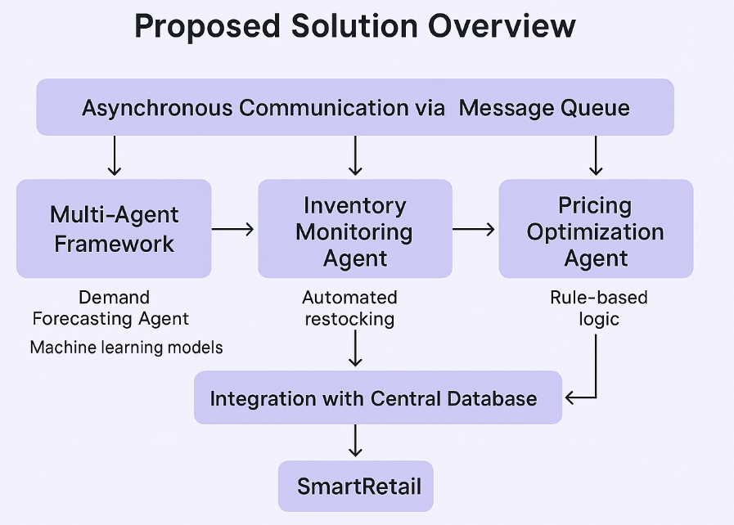
2) Asynchronous Communication via Message Queue (Kafka/RabbitMQ)
Agents exchange data using a publish-subscribe model, enabling:
Real-time decision-making
Scalability and decoupling of services
Fault-tolerant, production-ready architecture
3) Integration with Central Database
All agents read/write from a shared PostgreSQL/MongoDB data store to ensure consistency across forecasts, inventory, pricing, and sales records.

Slide 7
Technologies
Machine Learning and AI
Python – core language for all agents
Libraries: TensorFlow or PyTorch, scikit-learn, XGBoost/LightGBM, Prophet, NLTK / TextBlob ,Statsmodels, pandas / NumPy
Data Processing and Storage
pandas / NumPy
SQL, PostgreSQL or MySQL, MongoDB, Apache Spark – database
Communication Layer
Kafka/RabbitMQ
Dashboard and Visualization
Plotly / Matplotlib / Seaborn, Streamlit or Dash
Deployment and DevOps
Docker for containerizing services
docker-compose to orchestrate all agents + backend + Kafka + Zookeeper

Slide 8
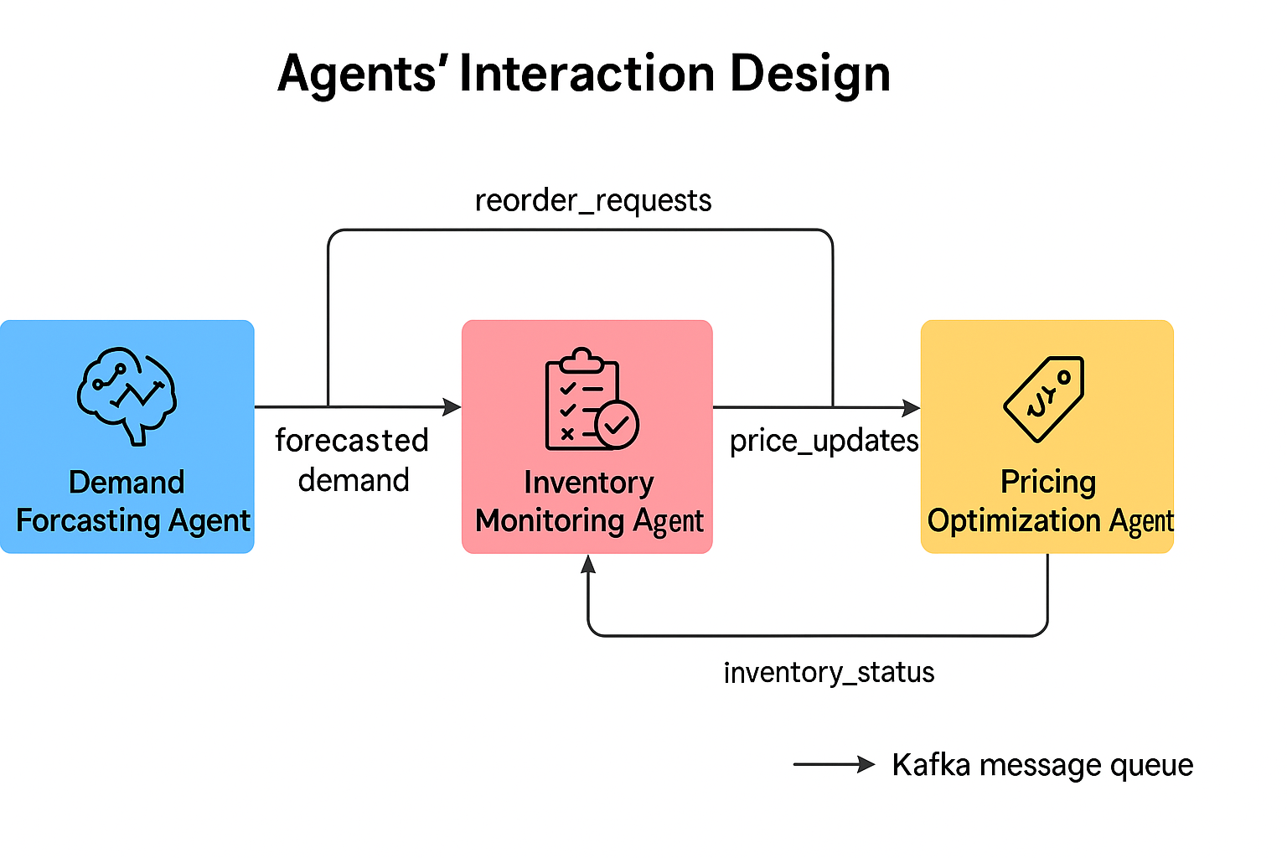
Agents' interaction design

Slide 9
Code structure
multi_agent_inventory_system/
│
├── agents/
│ ├── demand_forecasting.py
│ ├── inventory_monitoring.py
│ ├── pricing_optimization.py
│ └── agent_utils.py
│
├── kafka_layer/
│ ├── producer.py
│ ├── consumer.py
│ └── topics.py
│
├── django_backend/
│ ├── manage.py
│ ├── core/ # main Django project settings
│ │ ├── settings.py
│ │ ├── urls.py
│ │ └── wsgi.py
│ │
│ ├── api/ # app with API and DB logic
│ │ ├── models.py
│ │ ├── views.py
│ │ ├── urls.py
│ │ ├── serializers.py
│ │ └── admin.py
│
├── config/
│ ├── settings.yaml
│ └── .env
│
├── scripts/
│ ├── run_agents.py
│ └── load_data.py
│
├── requirements.txt
├── docker-compose.yml
└── README.md
The solution is built using a modular architecture with three independent yet collaborative agents — Demand Forecasting, Inventory Monitoring, and Pricing Optimization. These agents communicate asynchronously through Apache Kafka to ensure scalability and real-time updates.
The backend is developed using Django, which provides RESTful APIs and admin interfaces to interact with the agents and visualize system metrics. The architecture is designed for separation of concerns, making the system maintainable, extensible, and easy to debug or upgrade.
A central config layer manages secrets and settings, while utility scripts help automate agent deployment and data loading. The entire system is containerized using Docker for simplified deployment and scalability.

Slide 10
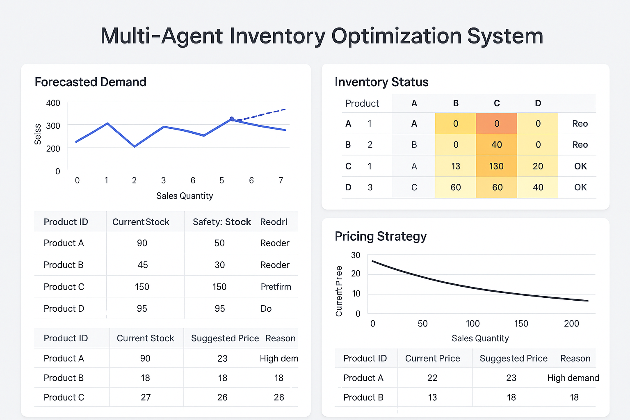
Demo video
Demo Video Link:- https://drive.google.com/drive/u/0/folders/14w-8fe42ScNqTgZFlaZj7_TPwyKLPfQw A dashboard sample:-

Slide 11
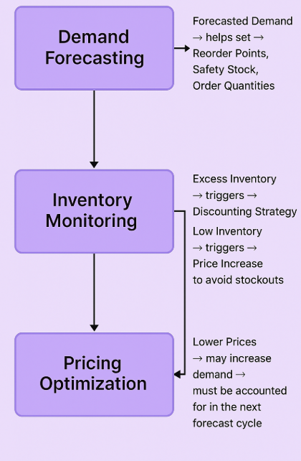
Conclusion
Impact and Effectiveness of the Solution
Smart-Retail provides a scalable, intelligent, and autonomous system that transforms traditional inventory management into a proactive, data-driven process by integrating machine learning with a multi-agent architecture, we address the core challenges of modern retail:
Prevents stockouts through accurate demand forecasting.
Minimizes holding and wastage costs by automating restocking decisions.
Increases profitability by dynamically adjusting prices based on supply, demand, and competition.
Solution
Each of the three agent i.e. Forecasting, Inventory and Pricing operates independently yet cooperatively, sharing insights in real-time via a message queue (Apache kafka). This architecture ensures the system remains responsive, fault-tolerant, and adaptable to real-world retail scenarios.
The result is a system that empowers retailers to:
Improve supply chain efficiency
Maximize sales revenue
Reduce manual workload
Smart-Retail not only solves the stated problem but also lays the foundation for the future of intelligent retail operations.
Three Agents

Slide 12
References/Other details
Research & Concepts:
Time Series Forecasting Techniques
Autoregressive Models, Prophet, LSTM
https://otexts.com/fpp3/
Inventory Management Strategies
EOQ, Reorder Point, Safety Stock
https://www.investopedia.com/terms/i/inventory-management.asp
Dynamic Pricing and Elasticity
Pricing Models in Retail
https://hbr.org/2017/06/a-refresher-on-price-elasticity
Real-World Use Cases:
Retail Chains: Dynamic pricing + auto restocking (e.g., Walmart, Amazon)
Grocery Stores: Preventing food wastage by linking expiry tracking to price drops
Festive Demand Spikes: Inventory boosted automatically before major festivals

Slide 13

Thank You

